Slide 1
Week 5 Tasks

Slide 2
Administrivia
Proposals due tonight, feedback by end of weekend
A1, A2 grades are out. 100% if we saw good faith effort
Poll: assignment for sampling?

Slide 3
Related Works phase of project
How does the project go beyond state of the art for your problem?
Not easy! Need to be creative in finding related papers
Many ways to be related
Motivates your problem
Provides a promising approach
Solves your problem, but you can do better
Solves part of your problem, but in different area
Solves different problem, but similar technique

Slide 4
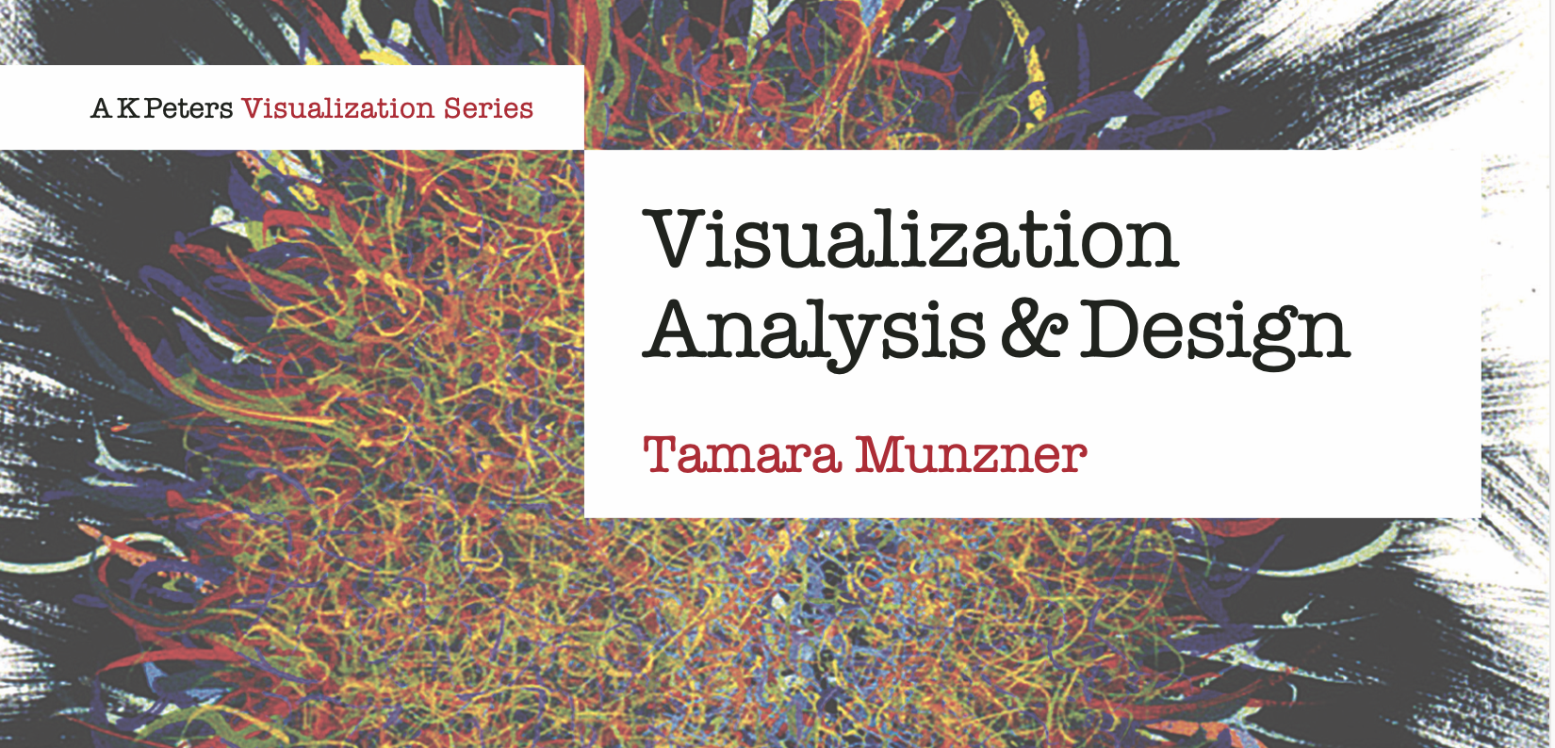
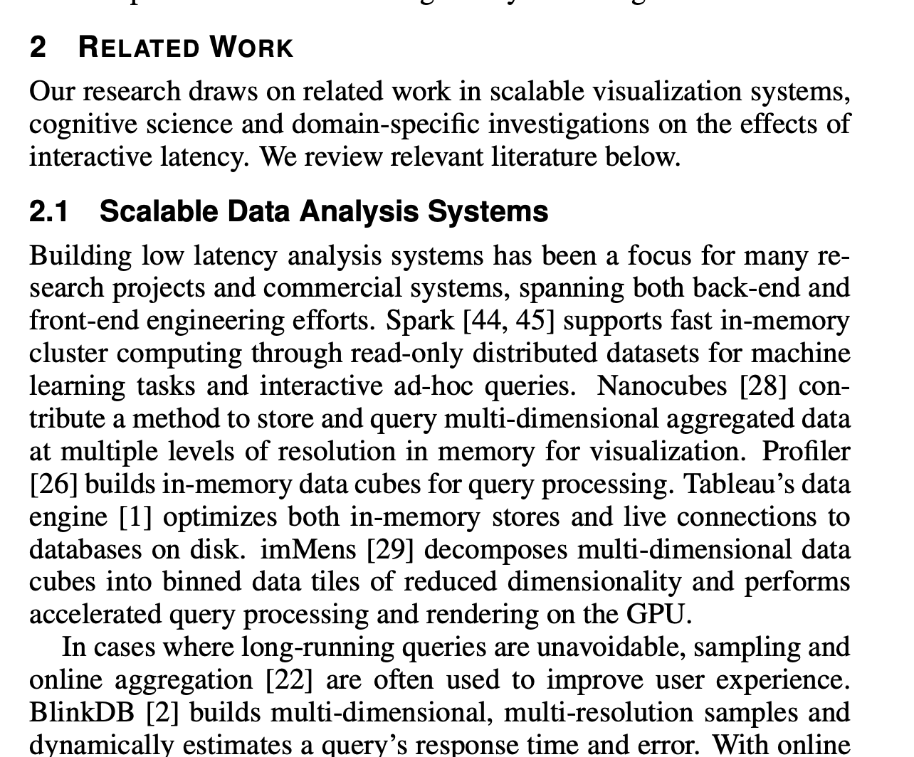
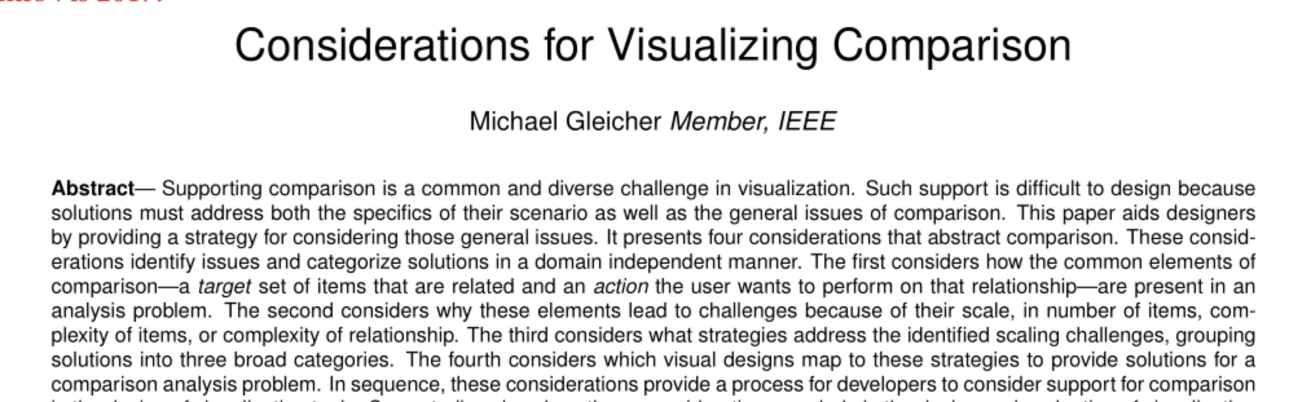
Textbooks, Surveys, Related Works

Slide 5
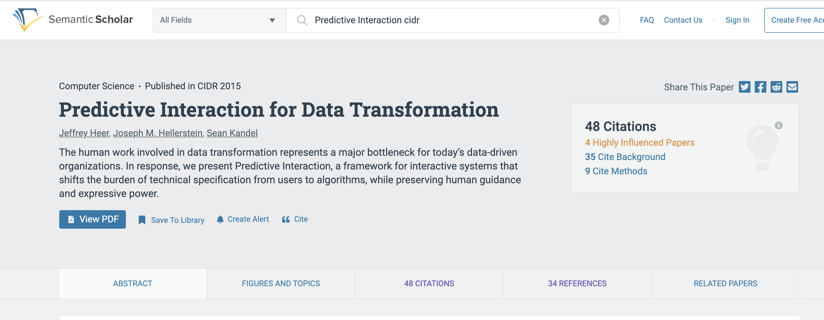
Semantic Scholar

Slide 6
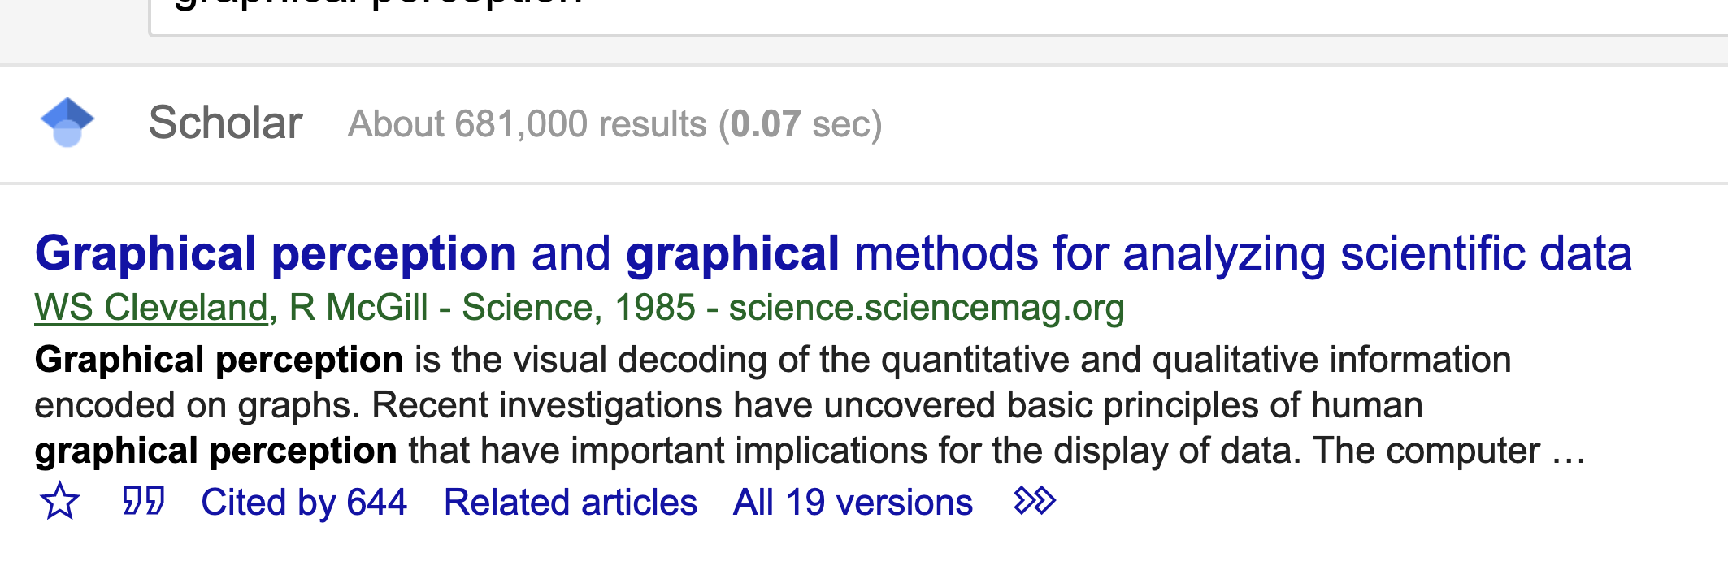
Google Scholar

Slide 7
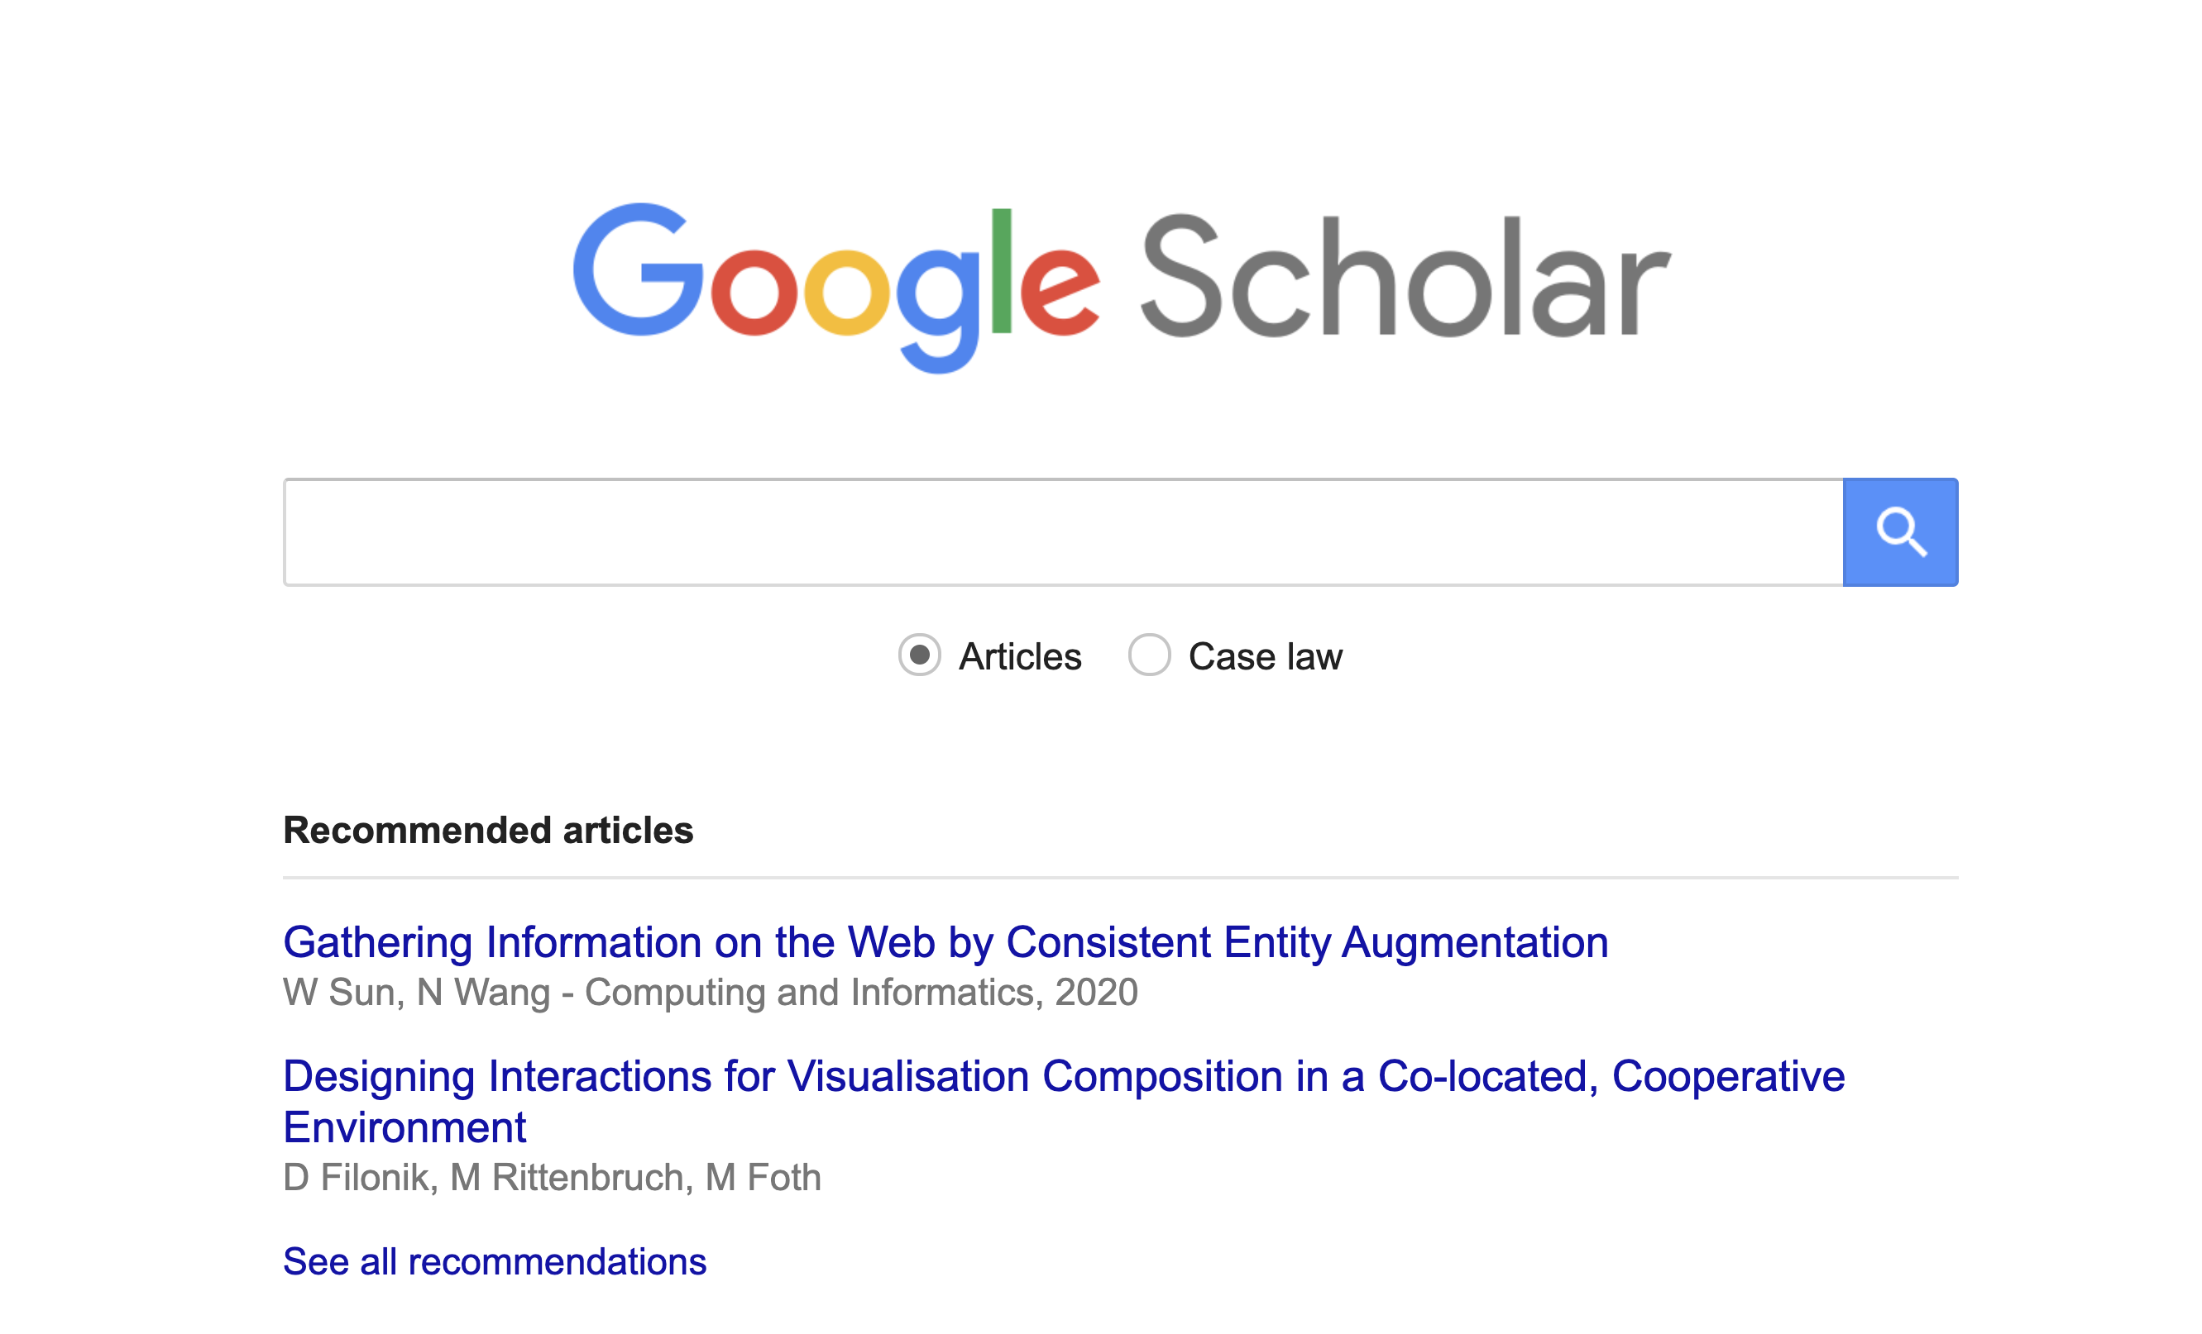

Slide 8
Administrivia
Tamara
Presenter: Alex Price
Scribe: Celia Arsen
Comparison
Presenter Celia Arsen
Scribe: Perrin Anto

Slide 9
Munzner Chapter 1 Discussion

Slide 10
Munzner Chapter 1
Tasks
Effectiveness & the design search space
Validation
What-Why-How

Slide 11
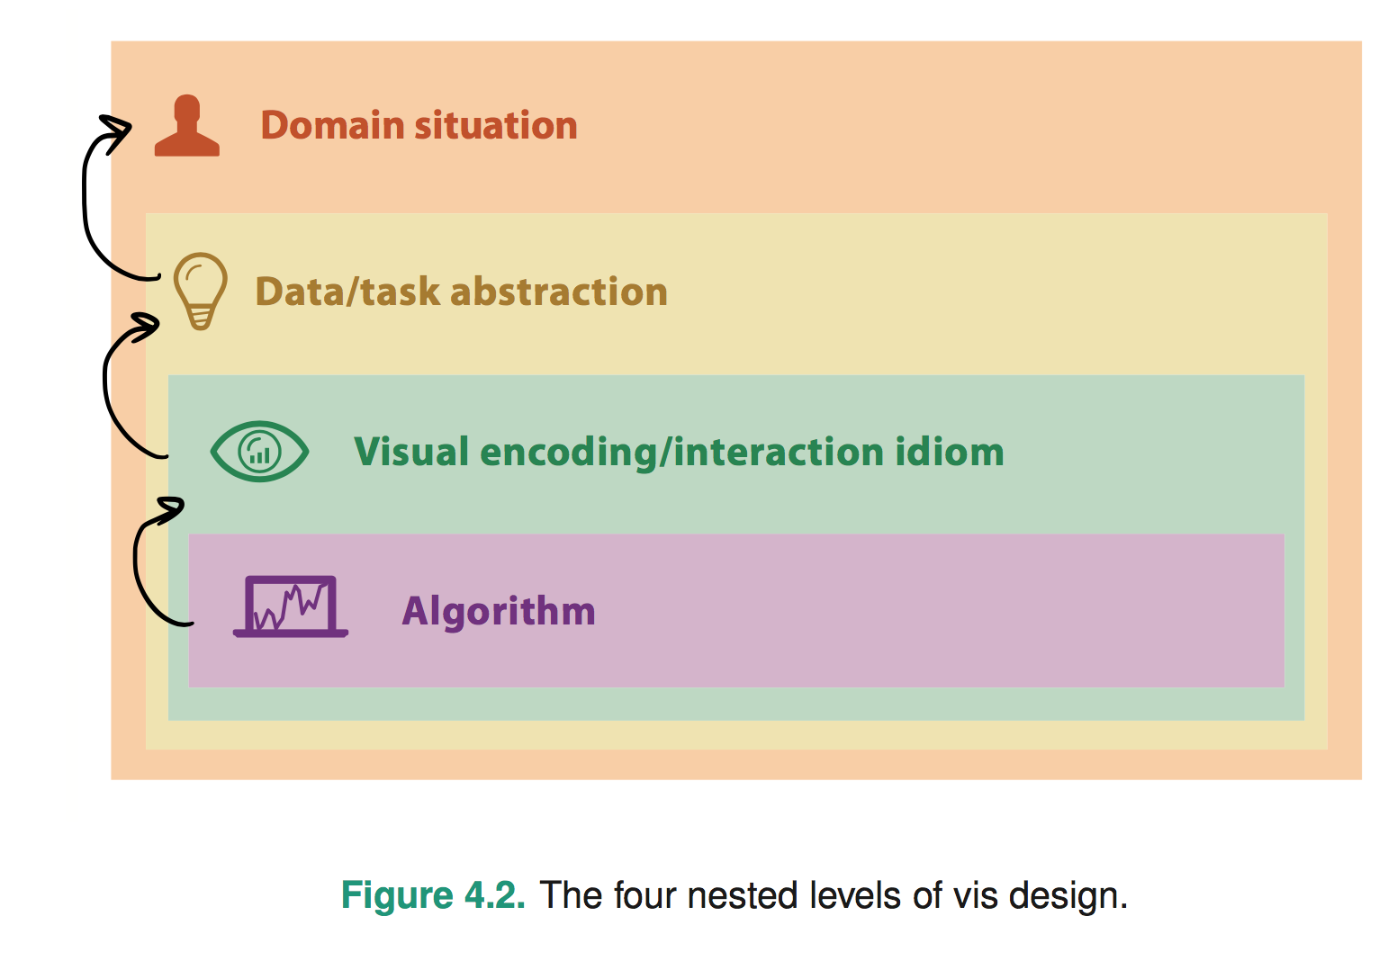
Chapter 4: The Nested Model
Politics, Genomics, Network monitoring, etc
What’s the goal? What data is needed? Talk to users!
Word tree, statistical graphic, etc
Considers perceptual/design issues for task
Computation and performance
Notes:
* early webvis papers soled "lost in hyperspace" by rendering the web's hyperlink topological structures. Not useful, and no idiom/algorithm could solve it, since it only added to user cognitive load

Slide 12
Chapter 4: The Nested Model
Wrong problem. Misunderstood user needs
Wrong abstraction. Showing the wrong thing
The way to show data is ineffective
Code is slow/buggy
Notes:
* early webvis papers soled "lost in hyperspace" by rendering the web's hyperlink topological structures. Not useful, and no idiom/algorithm could solve it, since it only added to user cognitive load

Slide 13
Comparison Paper Discussion

Slide 14
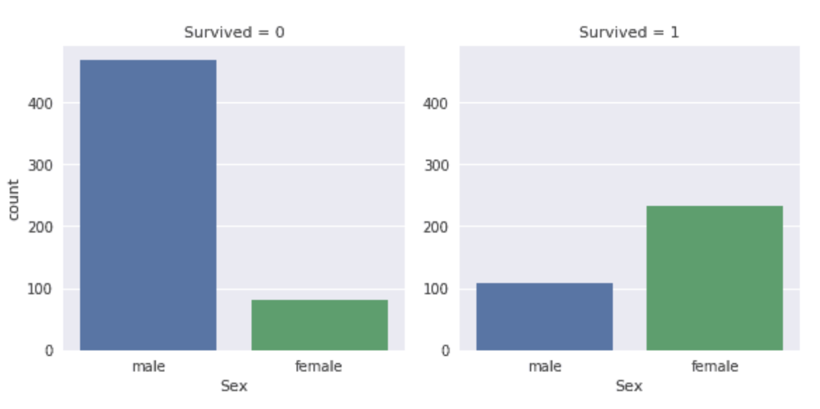
Targets?
Actions?
Naming?

Slide 15
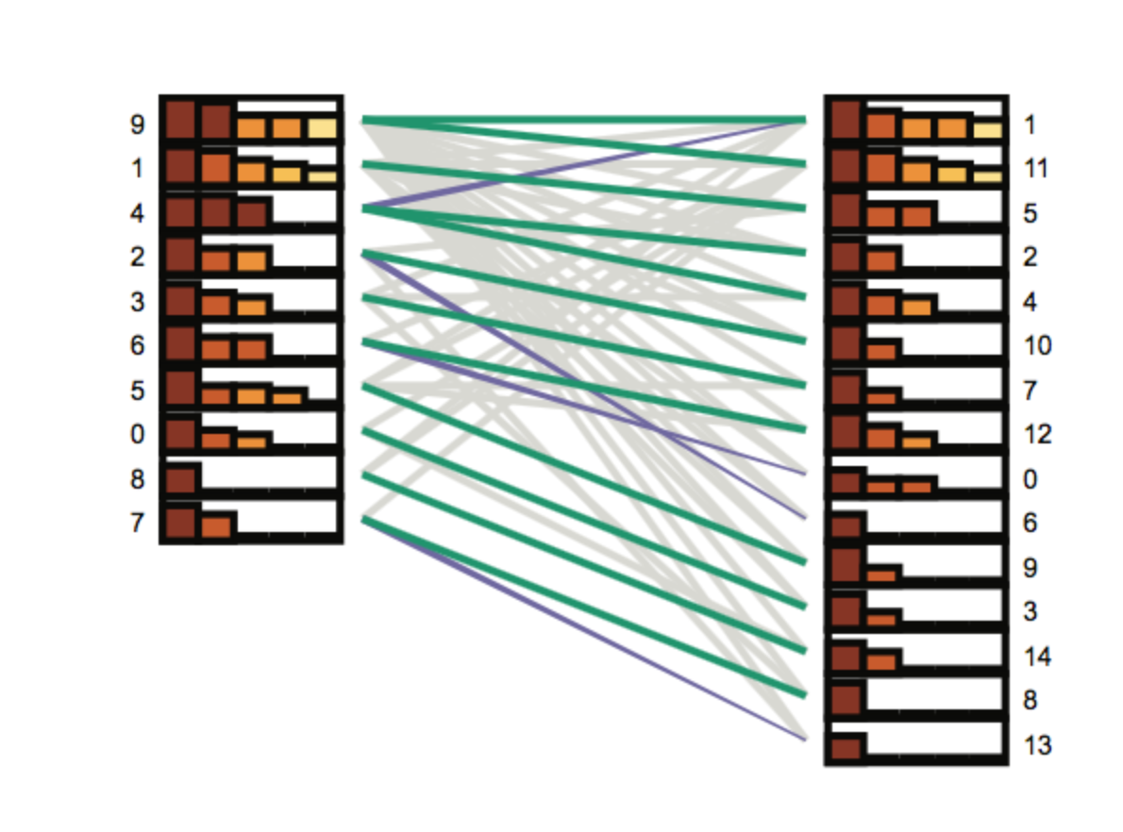

Slide 16
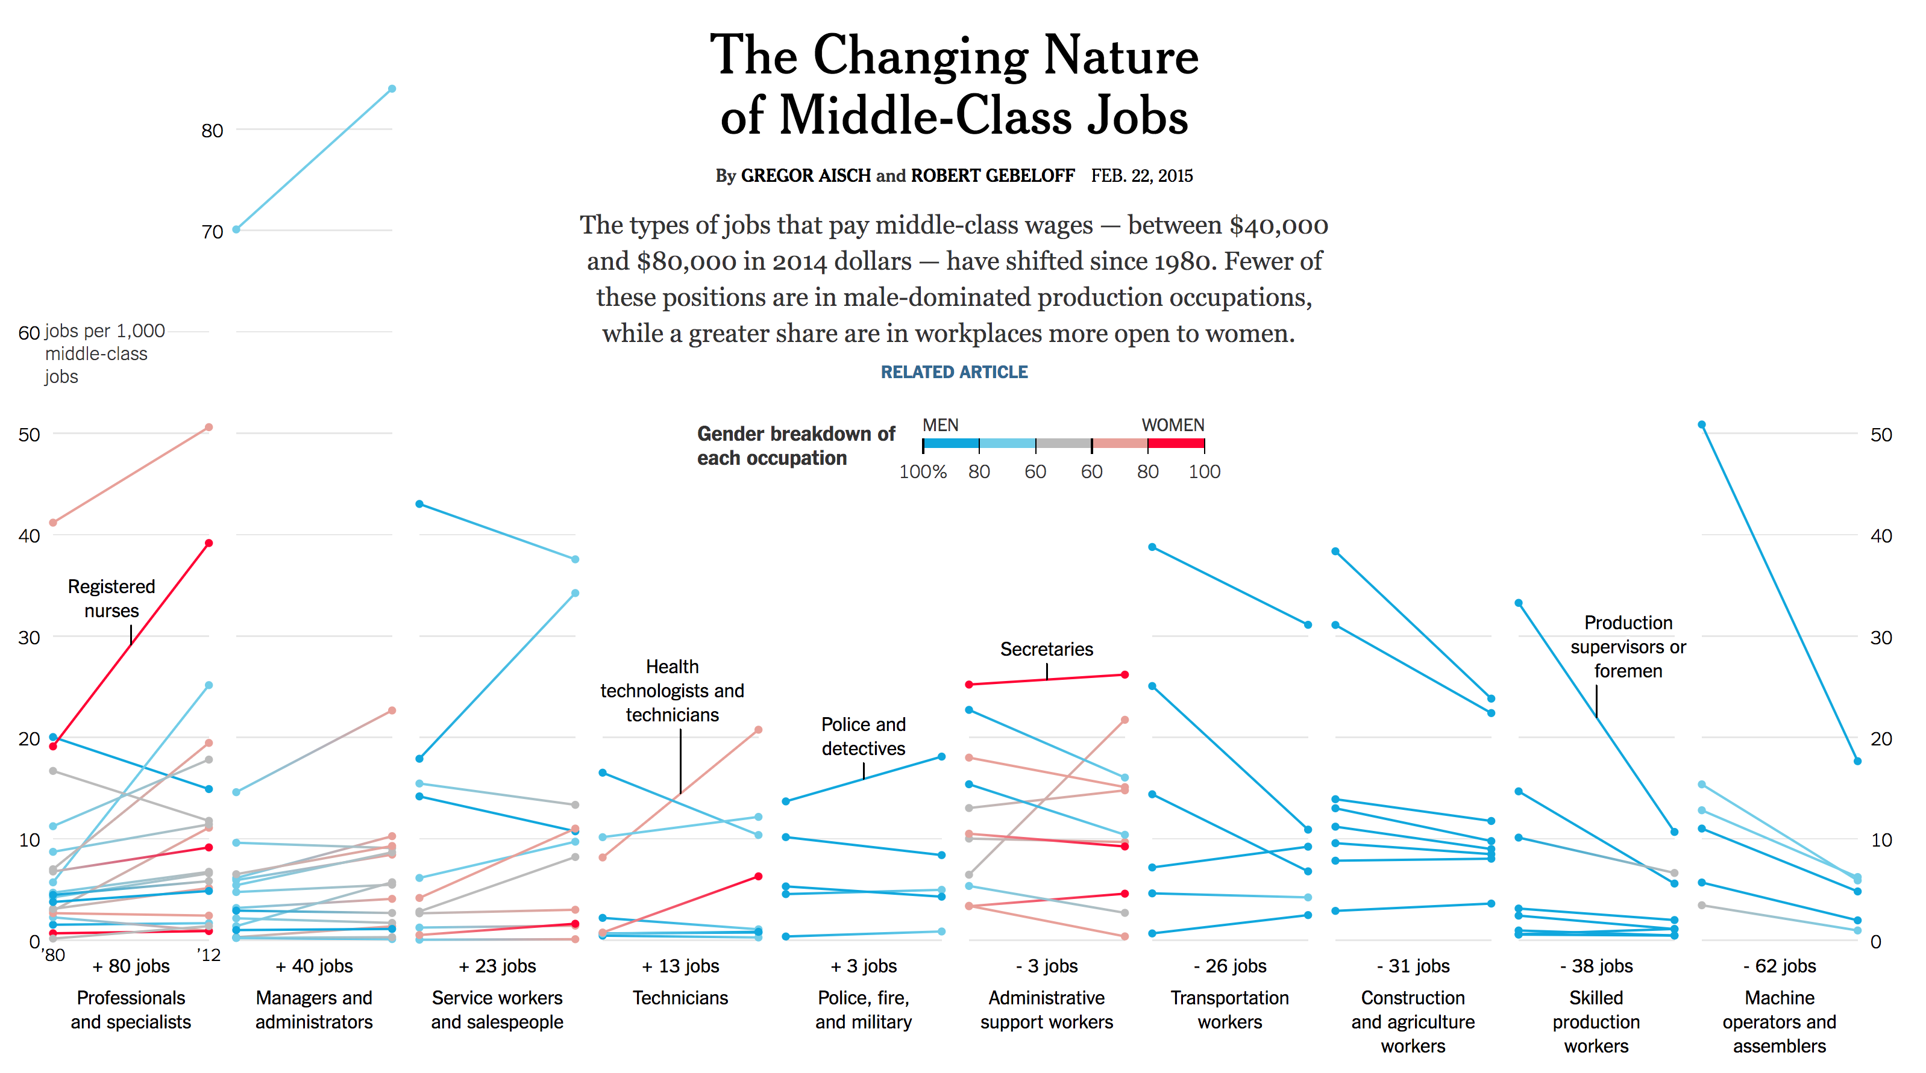
Notes:
https://www.nytimes.com/interactive/2015/02/23/business/economy/the-changing-nature-of-middle-class-jobs.html

Slide 17
Why was this paper written?
What purpose does it serve?

Slide 18
Are comparisons composed of target, action, & naming?
Are there other forms of challenges beyond scalability?
Strategies and Designs
Where does interaction play a role?

